Slide 1
A Healthcare Management System
Team D-NEXUS
DATABASE MANAGEMENT AND DATABASE DESIGN
INFO 6210

Slide 2
Problem Statement & Goals
The main objective is to develop a database that would maintain records of various components in the Hospital. It is only logical if system is defined in terms of relationships rather than a mere representation of the components.
The various components would include Providers, Nurses, Patients, Rooms, IT Management, Visitors, Finance, and Pharmacy. Each component has a distinct functionality and is inter-related.
IT management Department, a special addition to the hospital’s workforce, would track Asset Location and its Owner .
Emergency Manager dispatches Ambulances based on Requests from Information Desk and updates the request status accordingly.
Provide Improved Data Security and minimize redundancy.
Finally, we intend to improve upon the proposed model as Healthcare system is more evolutionary than revolutionary.

Slide 3
Actors
The various actors in our DB are
Doctor
Nurse
IT manager
Emergency Manager
Receptionist
Patient
Finance Manager
Inventory Manager

Slide 4
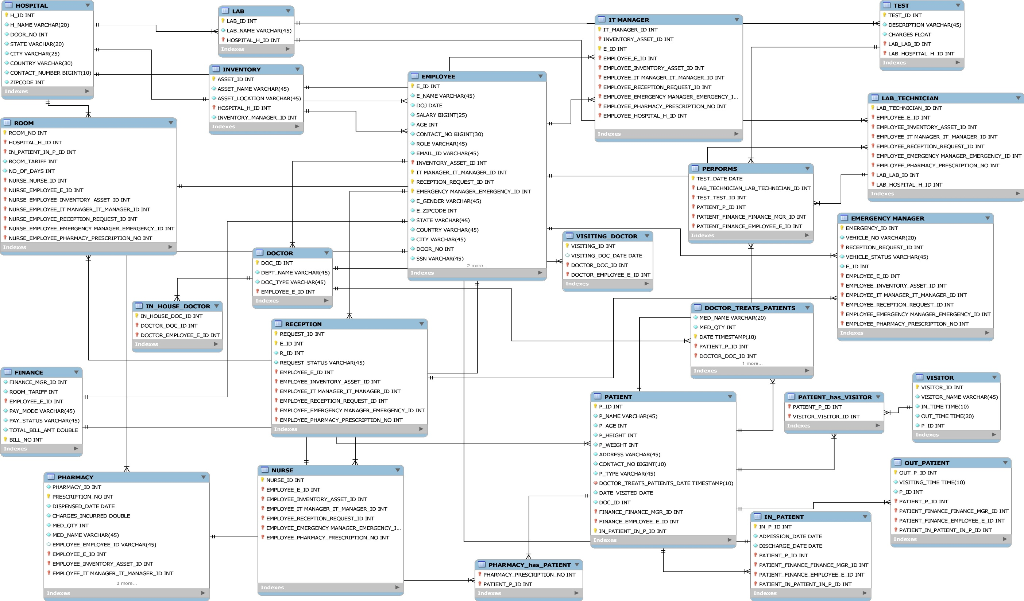

Slide 5
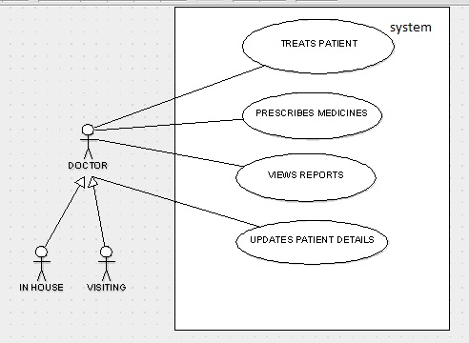
Doctor
Inserts and updates Patient Details
Treats Patient
Provide Prescriptions
Views reports

Slide 6
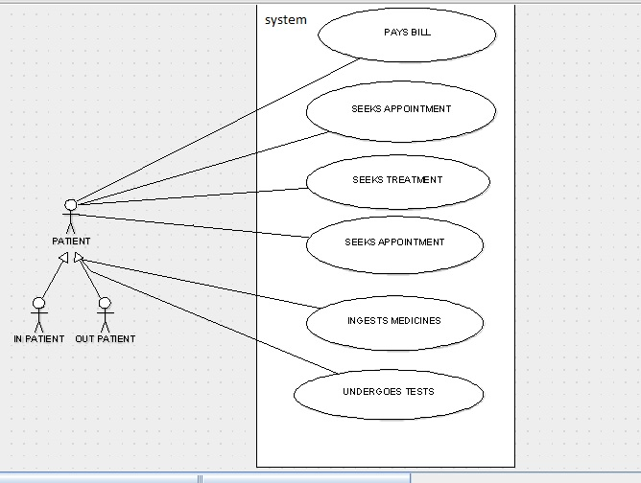
Patient
Seeks treatment
Ingests medicines
Undergoes tests
Pays bills

Slide 7
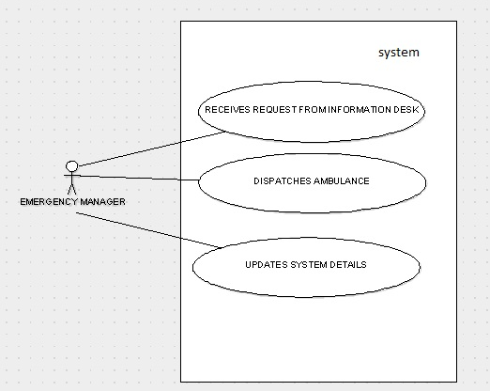
Emergency Manager
Receives request from Information Desk
Dispatches Ambulance accordingly
Updates system details

Slide 8
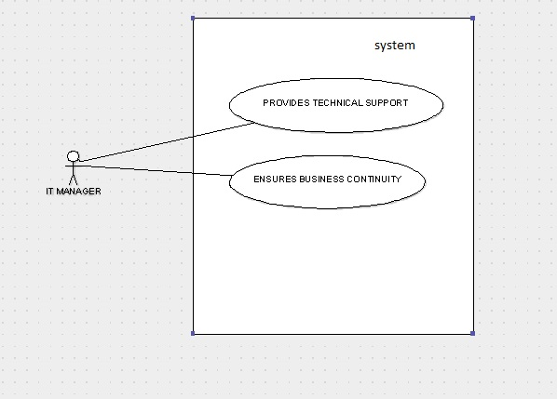
IT Manager
Provides technical support
Ensures business continuity

Slide 9
User Privileges
User | Privileges
ADMIN | Has all privileges over the database including GRANT option.
DOCTOR | Has all privileges over Patients Table and SELECT over DOCTOR Table
EMERGENCY MANAGER | Has Update Privileges over Emergency_Mgr Table
RECEPTIONIST | Has SELECT, UPDATE, INSERT privileges on RECEPTIONIST Table
FINANCE MANAGER | Has ALL Privileges over FINANCE, ROOM, and TEST tables

Slide 10
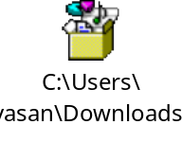


Joins
Scenario | Tables | Screenshots
To display all details of the employees in the Hospital | EMPLOYEE and EMPLOYEE_DETAILS
To view Asset Location and Asset Owner | IT_MANAGER and INVENTORY
To view the Status of emergency Requests and their owner. | RECEPTIONIST and EMERGENCY_MGR
To Track which Doctor is treating which Patient in which room. | DOCTOR, PATIENT, and ROOM
To View the Hospital Details | HOSPITAL and HOSPITAL_ADDRESS

Slide 11
Sub-queries
Scenario | Function | Screenshots
Fetch the list of employees who live in either ‘Boston’ or ‘Allston’ in ‘USA’. | AND,OR,ORDER BY
Fetch the Employee Name, who is in-charge of the LAB. | LEFT OUTER JOIN

Slide 12

Index
Scenario | Index Name | Screenshots
For employee ID and Employee Name from Employee table | employee_id
For Patient ID from Patient Table | patient_id

Slide 13
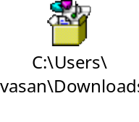
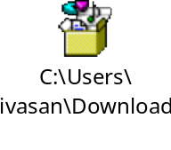
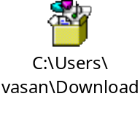
Transaction
Scenario | Screenshot
We have used transaction in the OUTPATIENT table to update the appointment timings of the patient. We have a save point, before we change his appointment. If the patient wishes to revert to the old timing then a rollback to the save point action is performed.

Slide 14
Views
Scenario | Table | Screenshots
To view Inpatient Details such as name, Date_Admitted, Discharge_Date | PATIENT and INPATIENT
To view Medicine Details such as Medicine_Name, Quantity_ Dispensed, Medicine_ID, Dispensed_Date, Charges_Incurred for a patient | PHARMACY, PATIENT, and PRESCRIPTION

Slide 15
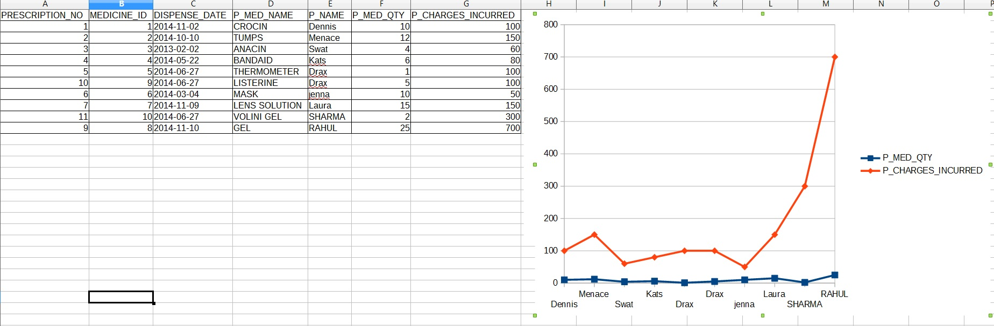
Business Intelligence for VIEW Scenario

Slide 16

Stored Procedure
Stored Procedure Scenario | Screenshots
Calculate the total bill amount in finance table. The total bill amount is calculated by taking charges from test table and multiplying room tariff and number of days stayed from room table
Display the Visitor Details for corresponding Patients

Slide 17
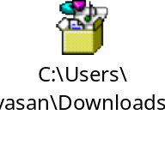
Triggers
Trigger Scenario | Screenshots
To change the Request_Status in RECEPTIONIST Table from “New” to “Closed” when the Status is updated in the EMERGENCY_MGR Table.
To call the Stored Procedure “Cal Total Bill Amount” after Inserting or Updating the values in ROOM Table and Test Table using the following triggers: After_Room_Insert After_Room_Update After_Test_Insert After_Test_Update After_OutPatient_Insert After_OutPatient_Update

Slide 18
Conclusion
We have covered
Triggers
Transactions
Sub-Queries
JOINS
VIEW
Stored Procedure
User Privileges

Slide 19
Thank you!!!!!

